Slide 1

ELECTRONIC – GOVERNMENT PROCUREMENT SYSTEM
(E-GP)

Slide 2
Presentation Outline
Challenges of the Manual Procurement System
E-GP – A Solution to Our Challenges
Objectives of E-GP
Benefits of E-GP
E-GP Steps
Integration with Other Systems
Target Implementation Period
Important Considerations
Conclusion

Slide 3
Challenges/Limitations of Current Manual Public Procurement Method
Lack of Transparency
Human interface at every stage leading to loss of objectivity
Disadvantage for geographically spread bidders to participate
Delays in finalization of tenders leading to several visits by bidders to PEs
Long chain of internal authorizations and scrutiny (at times involving several departments)
Government spending more on overpriced goods and services.

Slide 4
Challenges/Limitations of Current Manual Public Procurement Method….contd
Growing trend of sophisticated bidders and their pricing mechanisms.
Unethical conduct by PEs and bidders resulting in:
  None adherence to procurement plan.
  Loss of time on projects due to appeals
Lack of capacity in Procurement Entities resulting in:
  Mishandling of the procurement processes, procedures and records
Challenges in contract management
Generation of reams of paper-based statements and evaluations

Slide 5
E-GP System - A Solution to Our Challenges
  Embracing information technology in public procurement will greatly help in facing the challenges.
  What is E-GP System?
  Electronic – Government Procurement (E-GP) is the use of information and Communications Technology (especially the internet) by government agencies and other actors of the procurement community in conducting all activities of Government Procurement Process Cycle for the acquisition of goods, works, and services with good governance in procurement management. (Dr. Rajesh K Shakya, e-Procurement Specialist World Bank)
  ZPPA will not assume the role of buying on behalf of PEs

Slide 6
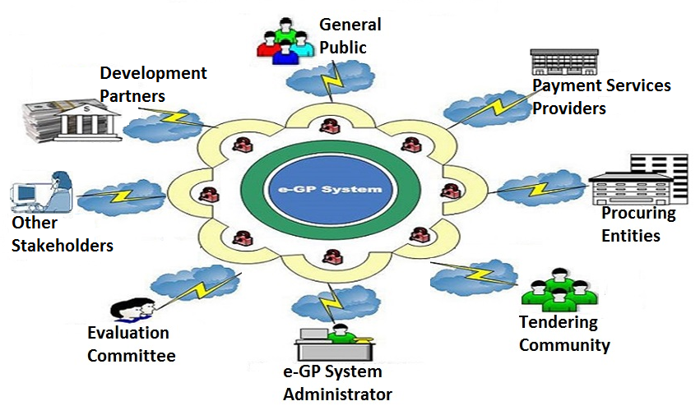
E-GP System Access Diagram
Diagram: Dr. Rajesh Shakya

Slide 7
Objectives of the E-GP System
Reduce the time and cost of doing business for both bidders and PEs
Realize better value for money spent through increased competition
Standardize the public procurement processes across govt. departments/agencies
Allow equal opportunity to all bidders
Bring transparency (good governance)
Social economic development
To make it easy for ZPPA to monitor compliance

Slide 8

Benefits of E-GP to Bidders
Reduces cost to bidders.
Greater transparency through the automated publication of tenders and contract awards
Automatic email alerts (Notifications), (e.g. confirmation of tender submission)
Automated compliance validation during bid submission therefore high chance of winning bids.
The tender document can be downloaded free of charge. Bidders will be charged at bid submission.
Search mechanisms allowing search for tender notices and contract award information.
Location independent leading to increased opportunities. Bid submission from anywhere.
Consistency of process and 24X7 accessibility.
Tenders are encrypted at the time of submission.
Both offline and online payment options.

Slide 9

Benefits of E-GP to PEs
Automatic viewing of all tenders online including past data for reference as all tender related information will be available online.
  Reduces time of finalization of tenders.
  Easy generation and sharing of management reports.
  Easier management of framework agreements.
  Simplify the publication of information to Bidders, Suppliers and the general public.
  Improve accounting and controlling possibilities of public procurement.
  Provides an effective audit trail.

Slide 10
Benefits of E-GP to ZPPA
Makes it easier for ZPPA to Monitor compliance
Allows integration with other stakeholders’ systems
Makes it easier for ZPPA to improve public procurement processes
Easy generation and sharing of management reports
  Provides an effective audit trail.

Slide 11

Benefits of E-GP to Government
Value for money because of demand aggregation, use of framework agreements.
Enhanced citizen trust in government, because of transparency in procurement through the publication of public information in each stage of procurement.
Reduction in procurement cycle to meet development agenda on time.
Reduction in corruption and malpractices
  reduction in face-to-face transactions
  anonymity of the bidders until bid opening
Efficient monitoring of contracts through e-contract management system.
Data availability to Government for better planning of procurement.

Slide 12

E-GP Modules
1. e-Registration
The e-registration module will provide a single interface for registration of all bidders, Procuring Entities, committees, oversight agencies and all other stakeholders who intend to use the e-GP system. All bidders must be registered to participate in bidding opportunities.
2. e-Tendering
Online process that manages the tendering lifecycle from advertisement of the notice to issuing of an award of contract.
3. e-Notification
This is basically a public procurement information portal that facilitates the publication of contract notices, awards, procurement plans, tenders, etc. by Procuring Entities.
4. e-Evaluation/ Awarding
This module will automate the evaluation process. The system shall have a facility to recommend evaluation results as stated in the Public Procurement Act and Regulations. This module will also facilitate the Notification of Awards (NOA).
5. e-Contract Management
The e-Contracts module is a dynamic subsystem of e-GP that establishes, manages and monitors contracts, collates bid history, monitors performance against agreed service level agreements (SLAs) and key performance indicators (KPIs) and alerts buyers to key events, such as contract renewal dates, etc.

Slide 13






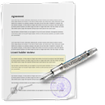

E-GP System Important Steps
1
2
3
4
5
6
7
REGISTRATION OF PEs, BIDDERS & OTHER USERS
PROCUREMENT PLANNING
Annual Procurement Plan
PREPARATION OF TENDER BY THE PE
Tender Notices
Invitations
PREPARATION OF THE BID BY THE SUPPLIER/BIDDER & SUBMISSION
BID OPENING
- Opening Report
BID EVALUATION
-Evaluation Report
- BEB Publication
- e-Award
CONTRACT MANAGEMENT
- Contract approval by A.G
- Project deliverables & milestones
ELECTRONIC NOTIFICATIONS

Slide 14
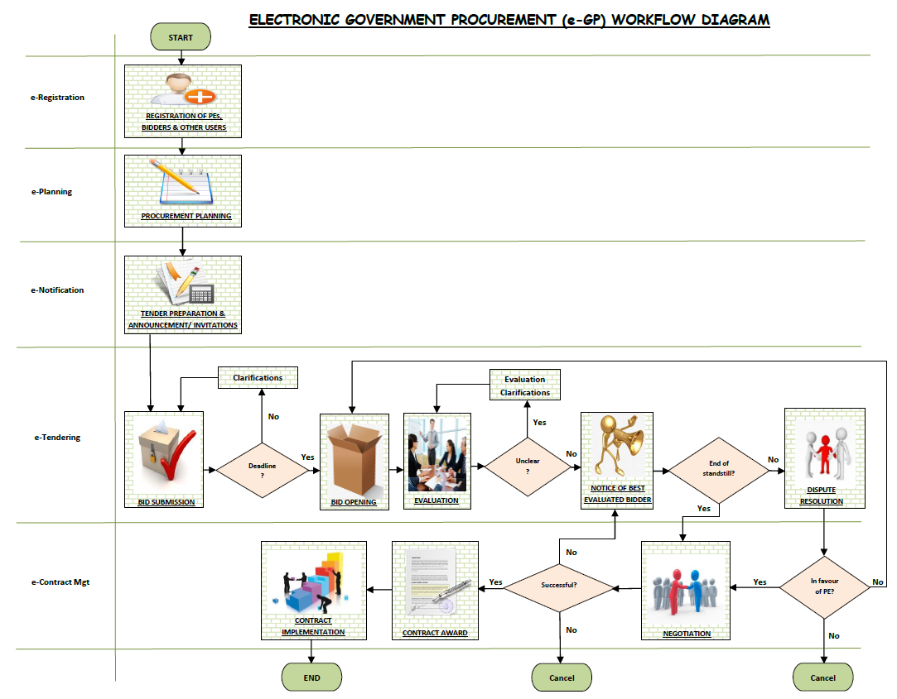
E-GP Workflow Diagram

Slide 15
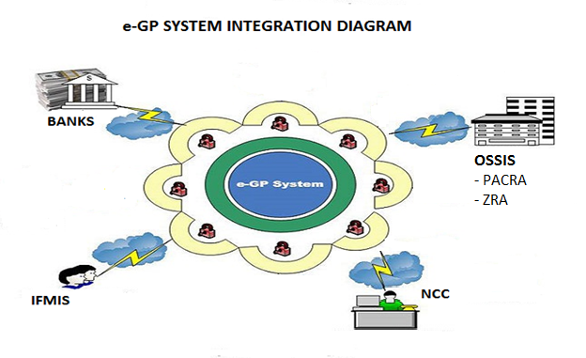
Integration of E-GP with other Systems

Slide 16
Target Implementation Period
Target Rollout of pilot sites July, 2016
Full Rollout 2017

Slide 17
Important Considerations
Framework Agreements
The e-GP system will allow for the establishment and management of framework agreements online.
2. Implementation of e-GP in Africa
Kenya success story
e-GP Helpdesk
A helpdesk will be available to all users of the system.

Slide 18
Conclusion
Questions from the Audience
Closing Remarks

Slide 19
THE END
THANKYOU!

